Slide 1
Šiauliai
Your next business location

Slide 2

Šiauliai city
Lithuania’s 4th largest city
Population of 101,2
Strong industrial sector (30% of the GDP)
Source: National Statistics Departments, 2014
Notes:
In Lithuania the name of Siauliai is the synonym of an industrial city. Even from a historical perspective Siauliai has always had a strong manufacturing sector. In fact, 30 percent of the GDP comes only from the industrial sector. As a result, we continuously develop our infrastructure and skilled professionals to meet the needs of businesses. And this has not come unnoticed.

Slide 3




They’re already here
Mechanical
engineering:
Electrical equipment
and home appliance:
Textile and leather
processing:
Other:
Manufacturing filtration and ventilation systems and products
Manufacture of electrical appliances, lighting and home decor products
Manufacture of cordage, rope, twine and netting
Manufacture of other plastic products
Manufacture of other furniture
Plastic molding of electrical components and consumer goods
Manufacture of net-based fishing trawls
Manufacture of corrugated paper and paperboard and of containers of paper and paperboard
Manufacturing of bikes and bike parts
Notes:
The proof that the city is an attractive place for doing business is showcased by a number foreign capital companies already carrying out business activities in Šiauliai.

Slide 4

“The key competences of workers, support from the authorities and easy access to global markets were the core factors which influenced ROL group’s decision to expand its business in Lithuania”
Rytis Dijokas – General Manager
Profile:
Production and marketing of height adjustable table stands
Production and supply of store fixtures
Metal processing services and subcontracting
FTE:
300+
Est.:
2006, Šiauliai
Notes:
The proof that the city is an attractive place for doing business is showcased by a number foreign capital companies already carrying out business activities in Šiauliai. According to ROL/STATGA, the biggest foreign capital company in the city: “The key competences of workers, support from the authorities and easy access to global markets were the core factors which influenced ROL group’s decision to expand its business in Lithuania”

Slide 5
Easy access to land, sea and air transportation chains
International
Airports
Seaports
Roads
Rail
Well-developed
Intermodal
Inter-linked
Notes:
The city is located in the northern part of the country which provides companies established in Siauliai with quick access to land, sea and air transportation chains making foreign markets easily accessible.

Slide 6
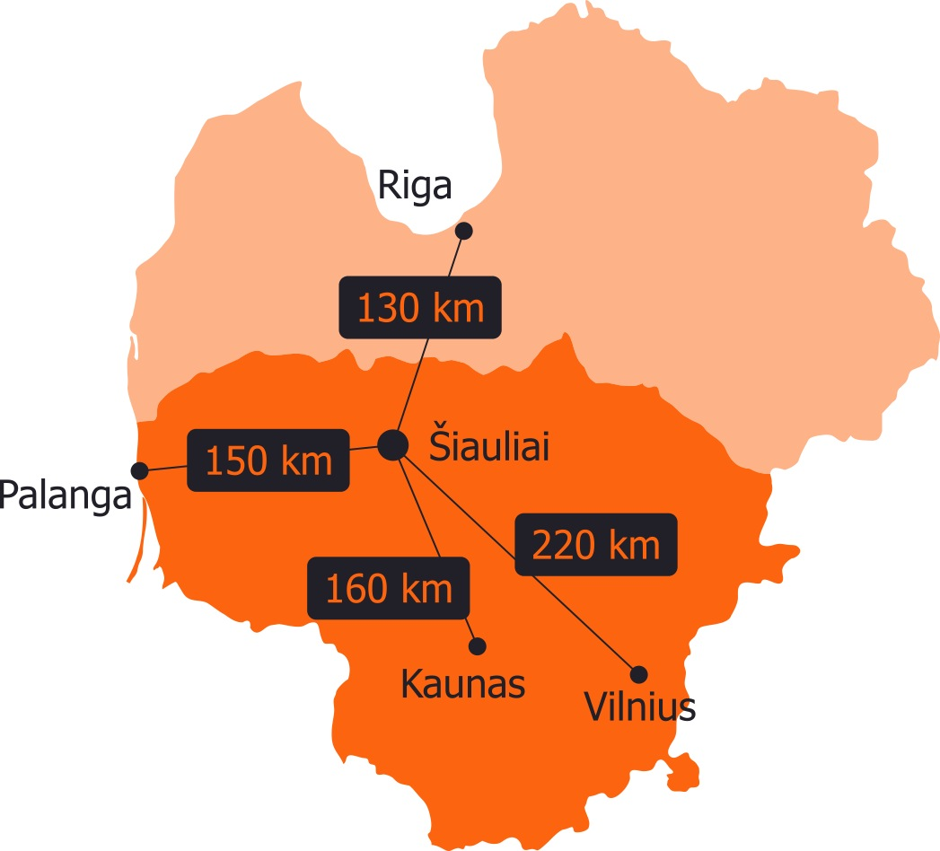
Šiauliai International Airport
Longest runway in the Baltics (3.5 km)
No noise restrictions
Other airports can be reached within 2-3h drive.
Source: Šiauliai City Municipality, 2014
*Kilometers are approximate
Notes:
Concerning air transportation, for example, Šiauliai has its own international cargo airport with the longest runway in the Baltic States. What is more, you can reach all major Lithuanian and Latvian airports only within 2.5 hours (on average) drive.

Slide 7
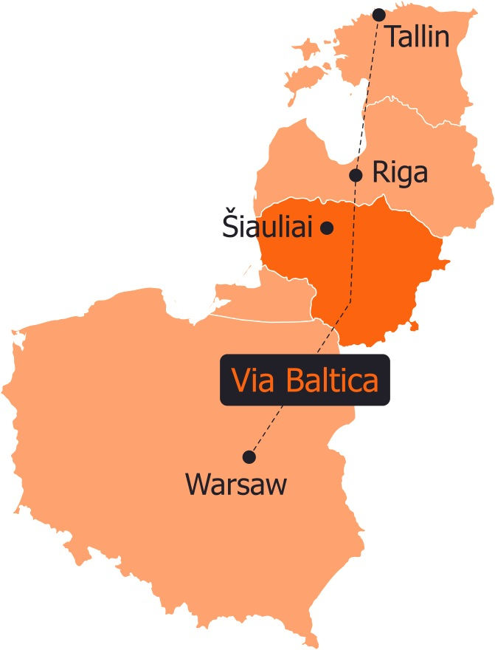
Roads
E272 connecting Šiauliai city with the highway „Via Baltica“.
„Via Baltica“ is a significant road connection between the Baltic states.
European route E67 is running from Prague to Helsinki by way of Poland, Lithuania, Latvia, and Estonia.
Notes:
Moving on to land transprtation, Šiauliai provides quick acces to the Via Baltica highway that stretches all the way from Warsaw to Tallin.

Slide 8
Rail
City is crossed by two international railway corridors:
  I North-South corridor - Tallinn-Riga-Kaunas-Warsaw and its branch - IA Šiauliai-Kaliningrad-Gdansk.
  IX East-West direction corridor and its branch - IXB Kiev-Minsk-Vilnius-Kaunas-Klaipėda.
Source: Lithuanian Railways, 2015
Notes:
What is more, the city is crossed by two international railway corridors.

Slide 9
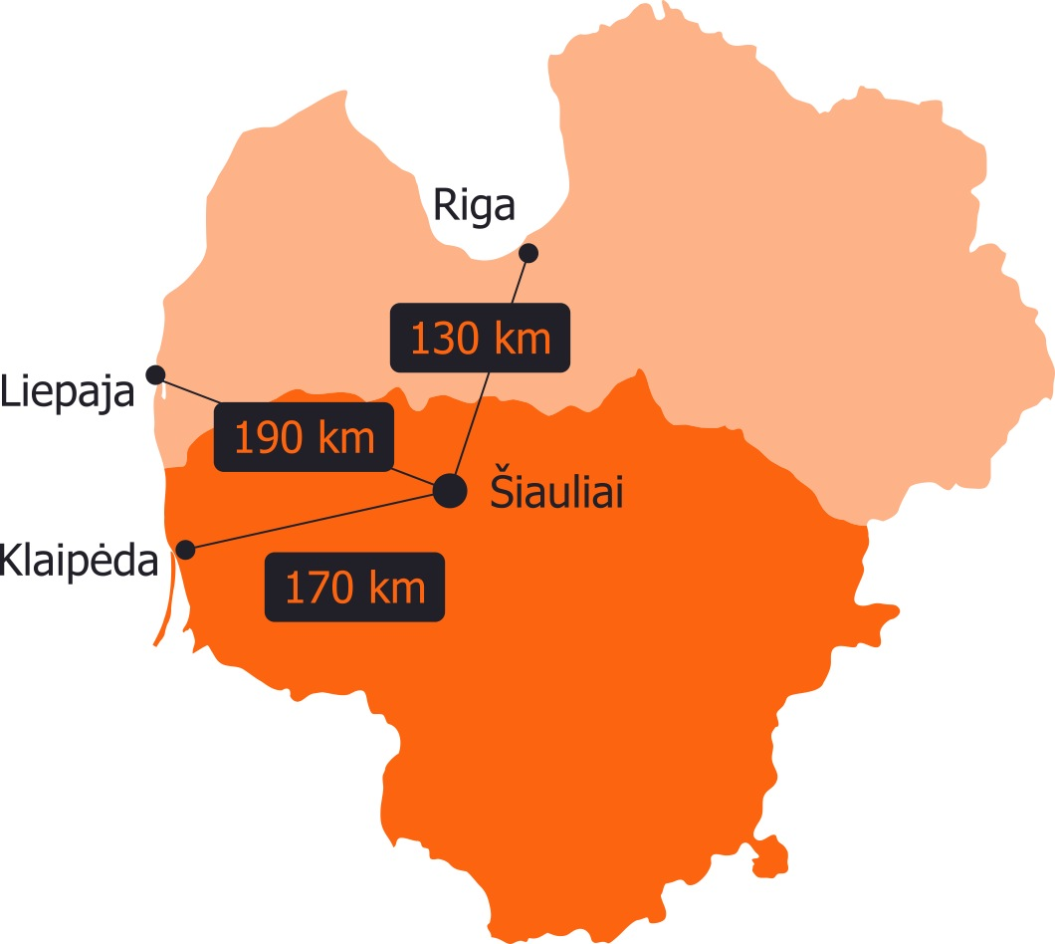
Seaports
Up to 2 hour drive to three major seaports.
Annual cargo turnover of ports in 2014:
  Port of Klaipėda - ~36 m tones
  Freeport of Riga - ~41 m tones
  Port of Liepaja - ~5.5 m tones
Source 1: Port of Klaipėda, 2014 Source 2: Freeport of Riga, 2014 Source 3: Port of Liepaja, 2014
Notes:
And last but not least, Šiauliai is just 160 km (on average) away from the 3 major seaports in Latvia and Lithuania

Slide 10
Economic growth and industrial competences
GDP growth (EUR bn.)
4th
2.50
2.56
2.33
in Lithuania by GDP
2.07
1.92
7.1%
of total GDP generated in Lithuania
2009
2010
2011
2012
2013
Source: National Statistics Departments, Šiauliai county data, 2014
Notes:
Talking about the economic situation of the city, even after the 2008 economic and financial crisis Siauliai is experiencing a steady growth in GDP and on the national level takes the fourth place in GDP growth. Siauliai region takes 7.1 percent of the total GDP of Lithuania.
Šiaulių apskrities bendrasis vidaus produktas (BVP) 2014 m. siekė 2 593,8 mln. EUR ir sudarė 7,1 proc. viso šalies BVP (Statistikos departamentas 2016-09-09 duomenimis)

Slide 11
Sectors with the highest turnover:
Mechanical engineering /
Machinery
Electrical equipment /
Home appliances
Textile and
leather processing
Source: National Statistics Departments, Šiauliai county data, 2013
Notes:
The three main sectors with the highest turnover include:

Slide 12
Foreign Direct Investment
Over 1,700 people employed by FDI manufacturing companies
53 percent of FDI - manufacturing
1,700
Top investing countries:
Denmark
The Netherlands
Germany
Sweden
Estonia
1,300
2011
2014
Source: Orbis, 2013
Source: National Statistics Departments, 2013
Notes:
When talking about the city’s GDP it is crucial to mention the importance of FDI. Accordingly, foreign businesses have already created over 1700 new jobs and contributes to the city’s economy with around 100,98 mln. EUR a year (Department of Statistics, 2014). According to the Lithuanian Department of Statistics, more than 53 percent of FDI is directed to manufacturing. Accordingly, est. 56 percent of the goods produced in Siauliai by foreign capital companies are exported to other countries. And if we had to indicate just one reason that makes the city attractive to investors it would be, without a doubt, our highly experienced and versatile workers with particularly storng competences in electronics, metal processing, furniture production etc.

Slide 13
Highly skilled and educated workforce
10.6%
6.9%
81%
̴̴ 51,000
Workforce
working in engineering industry
average annual growth in engineering talent available
Speak a foreign language
68%
Russian
10%
German
8.1%
35%
English
seeking employment
Source: National Statistics Departments, 2011-2013

Slide 14
The city’s greatest asset is its experienced workers specialised in …
Electronics
Metal processing
Furniture production
Other manufacturing skills

Slide 15
Qualifications and competences
Šiauliai city is home to a University, two colleges and one vocational school
Over 2,500 students are currently studying engineering programmes.^{[1]}
A well developed system of education institutions
Source1: National Statistics Departments, 2014
Notes:
This comes as no surprise as the city is home to a University, 2 colleges and 1 vocational school. At the moment there are around 2,500 enrolled in engineering programmes.
We are also very proud of our well developed system of education ranging from pre-school to university or professional education.

Slide 16
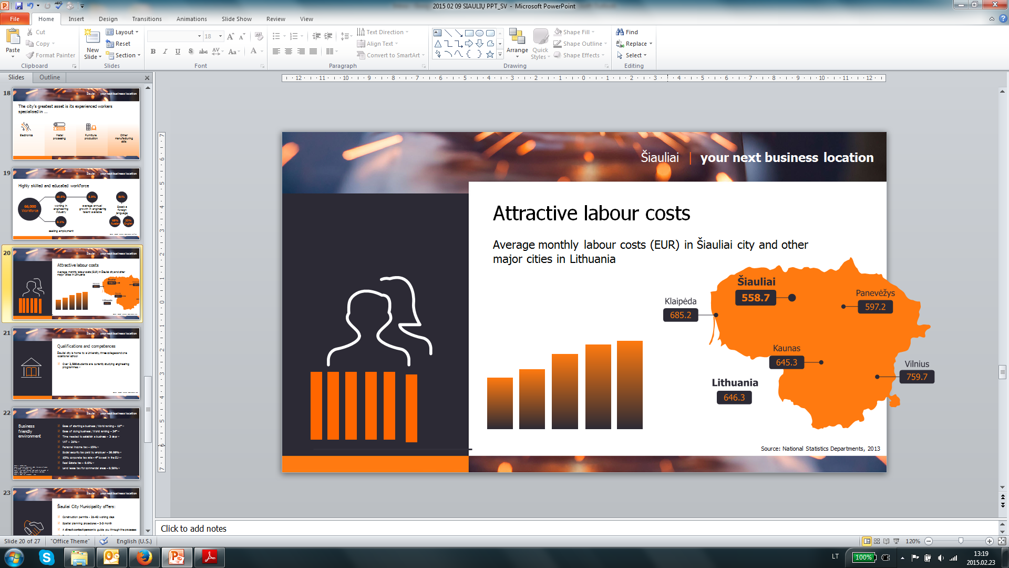
Attractive labour costs
Average monthly labour costs (EUR) in Šiauliai city and other major cities in Lithuania
828,0
791,1
742.3
714,1
717,8
620,6
Lithuania
Vilnius
Kaunas
Klaipėda
Šiauliai
Panevėžys
Source: National Statistics Departments, 2015
Notes:
Not only does the city provide skilled workers, Siauliai also offers very competitive labour costs with the average salary (BRUTO) being 658,8 EUROS

Slide 17
Territory for the development of
industry, business
and logistics
Free Economic Zone
500
ha
Šiauliai International Airport
Šiauliai Industrial Park
Source: Šiauliai City Municipality, 2014
Notes:
Apart from its skilled workforce, the city provides investors with a territory of 500 ha for the development of industry, business and logistics. The industrial park has already proven to be a success and is almost fully taken up by companies. The newly opened FEZ takes up 218 hectares.

Slide 18
The Siauliai Free Economic Zone
Territory: 218 hectares
Only 6 km away from the city
Next to the International Šiauliai Airport
Well-developed infrastructure

Slide 19
Well-developed infrastructure in FEZ:
Electrical services
Telephone
and
cable
Water supply main
Sanitary sewer line
Storm drainage system
Gas
pipeline
average pressure
300
mm
600
mm
800
mm
PE O
~400
Source: Šiauliai City Municipality, 2014

Slide 20
Favourable land and real estate tax incentives in FEZ
Tax on profits
Property tax
0%
Tax on dividends
0%
0%
(first 10 years)
50%
of standard tax rate
(subsequently 6 years)
Source: Šiauliai City Municipality, 2014
Notes:
Other very important advantage provided specifally by the FEZ is the availability of various tax incentives, including:

Slide 21
Business friendly environment
Construction permit : 21-42 working days; our practice – 14 days
Environmental impact permit: just 1 day if no issues are identified
A direct contact person to guide investors through the processes
Notes:
Regardless of the incentives, however, Siauliai in general has a very business friendly environment, to name just a few factors
The municipality further contributes in the creation of a business friendly environment by offering quality services

Slide 22
Business friendly environment
Possibility to negotiate with the municipality for land lease (0.81% ) and real estate tax (0.75%) deductions
Help with public transport, street infrastructure and sidewalks
Notes:
The municipality further contributes in the creation of a business friendly environment by offering quality services

Slide 23
So why Šiauliai?
Strong industrial competences and development potential
A laborpool of 51,000 skilled workers
Easy access to all transportation chains
Favorable legal environment and good infrastructure
Pro-active local authorities always ready to help the investors

